Slide 1
HADI Tutorial
Templates
20151101

Slide 2
Contents
Template based Inspection
Where are the Templates
Create a Template
Show a Template
Template is Locked
Cannot move or edit ROI
Edit a Template
Apply a Template to an Image
Template Settings

Slide 3
1. Template based Inspection
The concept of Template-based Inspection is that,
Create a Template through load an image.
Put some ROIs or other Tools on the Template.
For all incoming similar images, HADI will do the image alignment that align the incoming images to the selected Template.
And the HADI will map all the ROIs and parameter settings of the selected Template to the images.

Slide 4
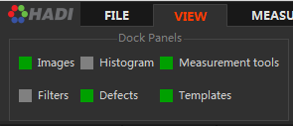
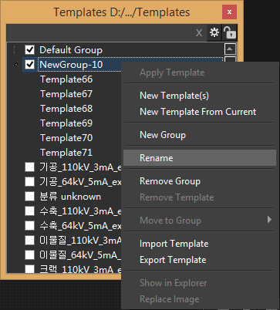
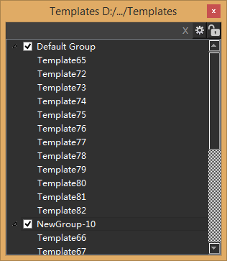
2. Where are the Templates
Goto “VIEW” and check “Templates”
In the beginning, only “Default Group” is shown
User can create new group and rename it.

Slide 5
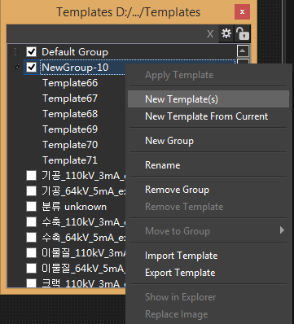
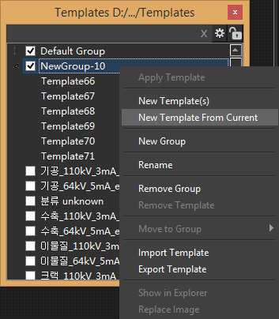
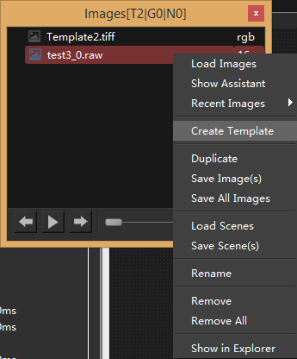
3. Create a Template
Some other method
In image dock panel, right menu -> “Create Template”
In “VOID INSPECTION” -> “Create Template”, will create a Template from current displaying image. All ROIs and parameters will also copied.
Two methods in right menu
Create a new Template by loading an image from disk
Create a new Template from current displaying image

Slide 6
4. Show a Template
Double click on Template item can show a Template
Single click will only select this Template.
If there are too many Templates, user can choose to load group
Check the group will load group Templates immediately.
Uncheck the group, HADI will not load the group Templates next time.

Slide 7
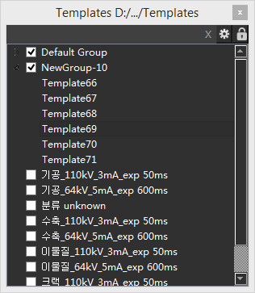
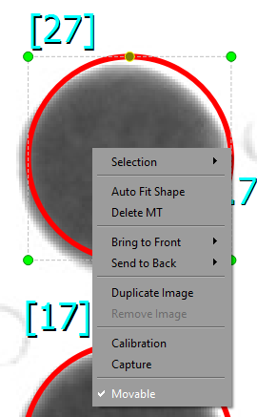
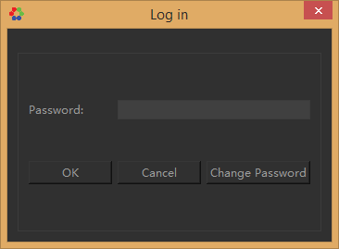
5. Template is Locked
By default, Template panel is Locked, user cannot edit Templates
Click on “Lock” Button, a log in dialog popup, default password is “3dii”.
If you lost password, please contact with us (kangho.lee@3dii.net)
After login, user probably still cannot edit template because the position is fixed for each ROI
It is for mis-operation
User needs to make ROI movable
Right click on ROI, check “Movable”
Or “Ctrl+A” select all ROIs, right click to check “Movable”

Slide 8
5-1 Cannot Move and Edit ROI
User can make ROI editable by
Right click on ROI, check “Movable”
Or “Ctrl+A” select all ROIs, right click to check “Movable”

Slide 9
6. Edit a Template
Double click on Template item in “Template Dock Panel”
The template is shown
All the operation on Template will be automatically saved.
User just edit Template as a common image is OK.
The following parameters will be automatically saved in Template
BGA Inspection Parameters
Void Inspection Parameters
ROI and all ROI Properties
Position
Size
Rotation
Color
Font
Parameters
Etc.

Slide 10
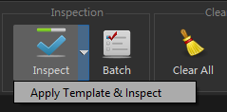
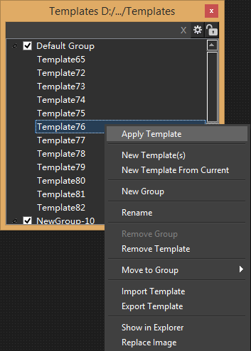
7-1. Apply a Template to an Image
Load an Image and display it
Right click on Template and choose “Apply Template”
Everything (ROI, Properties) inside Template will be applied to the currently displaying image
Display Image can also be changed, see next slide.
In “VOID INSPECTION” tab
“Apply Template & Inspect” will apply currently selected Template to current displaying image.
If your currently displaying image is a Template, and you choose to apply Template, all the ROIs will be duplicated. Please care about this.

Slide 11
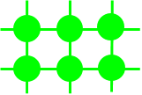
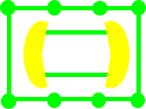
7-2. Apply a Template to an Image
Apply a Template to an Image will also change the target image
To put the ROI in the right position, the target image will be translated, rotated, scaled a little bit.
Image Alignment
Template image
Target Image
Target Image will be corrected

Slide 12
8-1. Template Settings
Select one or multiple Templates, and click on
Use Image Alignment
User can choose to use the image alignment or not.
In general, the incoming image and Template have some different transformations (rotation, translation, scaling etc.). That’s because of X-Ray machine cannot get the exact position (especially offline inspection) for each incoming image to map with Template.
Maximum Score
For each alignment iteration, a score will be calculated. After alignment process done, a score which calculates the sum of intensity differences between image and Template is gained. If the score lower than defined score, the alignment process is succeed, or else, “Image Alignment Error” will be displayed in the main window.
The default score value is 1000. In 1000x1000 resolution images, if
the brightness doesn’t change much and
the translation less than 200 pixels and
the rotation less than 30 degrees.
The alignment score value is about 500~1000. For larger image like 1500x1000, the score can over 1000, about 1500.
Set Alignment Speed
Set the alignment speed, default is 4 times faster than normal.
Obviously, set higher speed will bring less accuracy.

Slide 13
8-2. Template Settings
For advanced Image Alignment
Use Affine Transformation
Use affine transformation to align incoming image and Template (image). The affine transformation supports image translation, image Rotation, image scaling and image shearing.
The image alignment process will consider all the above transformations.
Use Rigid Transformation
The image alignment process will only consider Translation and Rotation between incoming image and Template
Use Edge-based Alignment
The default image alignment is using image intensities as the major factor. In some case, the brightness and contrast between incoming image and Template changes a lot. Since the alignment score is a sum of intensity difference between incoming image and Template, it will become abnormal even the image structure (object layout) are exactly same.
So for the image that have the similar structures with Template but brightness is quite different, use edge-based alignment would be better. The edge information shows the structure while ignoring the intensity values. The brightness differences can be ignored.

