Slide 1
HADI Tutorial
HADI Usage
20151101

Slide 2
Contents
System Requirements
Capture Image
Calibration
Properties of Measurement Tools
View and Display
Show Histogram and Profile
Use Image Filters
For 16-bit Image
Measurement Tools

Slide 3
1. System Requirements
To better use HADI, please follow the system requirements
 | Minimum Requirements | Recommended Requirements | Inline Inspection Requirements
OS | Windows 7 | Windows 7 | Windows 7 64bit
HDD | 20GB | 200G | 500GB or Higher
SSD | None | 128G | 128GB or Higher
CPU | Intel i5 | Intel i7 | Intel i7 3.40 GHz or Higher
RAM | 2G | 4G | 8G
GPU | None | Individual Graphic Cards | Individual Graphic Cards
Display Resolution | 1920 x 1080 | 1920 x 1080 | 1920 x 1080
Additional Apps | None | Microsoft Office PDF Reader | Microsoft Office PDF Reader
Network | Required | Required | Required

Slide 4
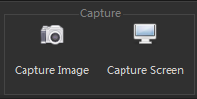
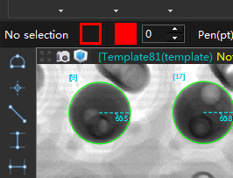
2. Capture Image
User can use HADI to capture image
  Click “FILE” -> “Capture Image”, HADI will save the current displaying image.
  Or click on the camera button on a view
User can also capture the whole desktop
  Click “FILE” -> “Capture Screen”
  Or use “Ctrl+1” to active it.
Get higher quality image
  Goto “Settings” -> “General” -> “Capture Image”, adjust default image quality.
  “X 3” means the captured image resolution is 3x3 = 9 times of original resolution.

Slide 5

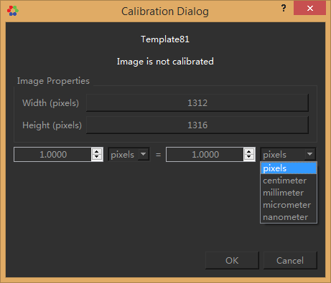
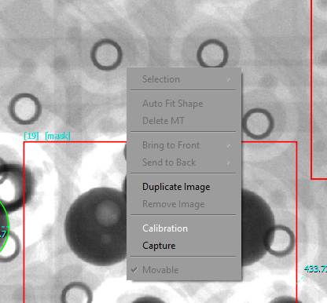
3. Calibration
For current displaying image, if user wants to make a connection between pixel size and real size.
  Goto “FILE” -> “Calibration”
  Or right click on view -> “Calibration”

Slide 6
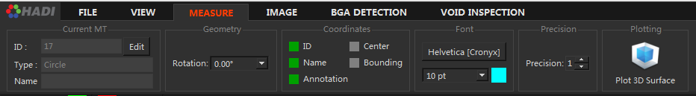
4. Property of Measurement Tools
Click on any Measurement Tool
Goto “MEASURE” tab, user can
  Change the ID, Name, Rotation
  Show the ID, Name, Annotation etc.
  Change the font size and font type
  Change the precision
  Or Plot 3D surface of the Measurement Tool
User can also change
  Border color, fill color
  Pen size and pen type
Border Color
Fill Color
Pen Size
Pen Type

Slide 7
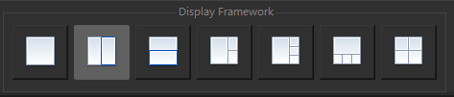
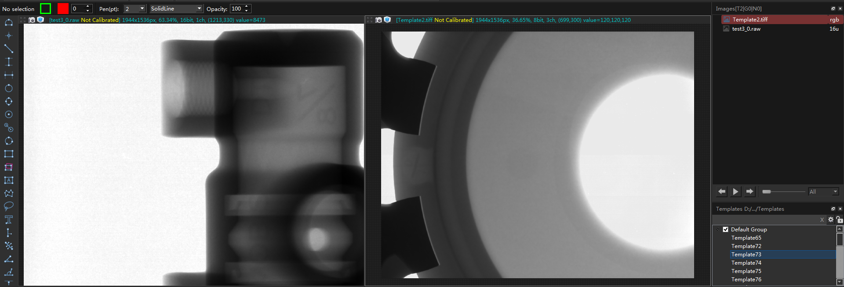

5. View and Display
User can use multiple view by click on “VIEW” -> “Display Framework”
User can active a view, and then click on Image item, the view will show that image.
For each View
  Some information are shown on top part
    Image name
    Calibration info
    Resolution
    Zoom ratio
    Pixel type
    Channel
    Mouse position (of image)
    Intensity value

Slide 8
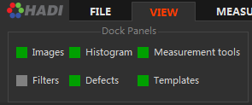
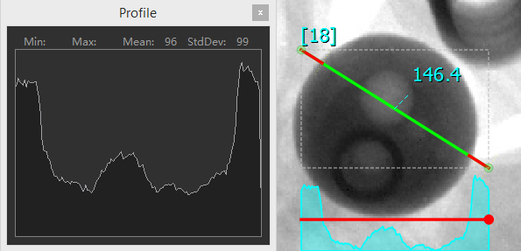
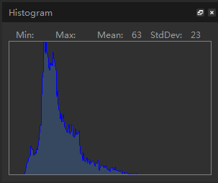
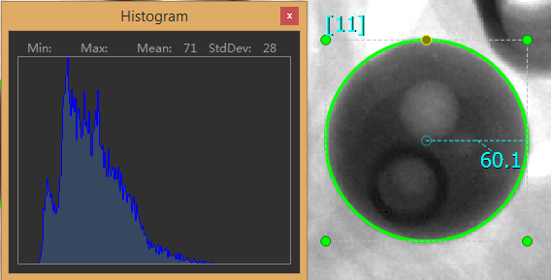
6. Show Histogram and Profile
Click on any ROI
  If it is closed shape, like circle, polygon, rectangle, the dock panel shows the Histogram of ROI image
  If it is non-closed shape, like lines, it shows the profile of it
If no ROI selected
  It shows the image histogram
Open the Dock Panel here
The histogram dock panel is appear
Show Profile of non-closed shape
Show Histogram of closed shape

Slide 9
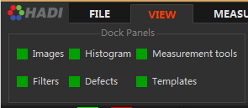
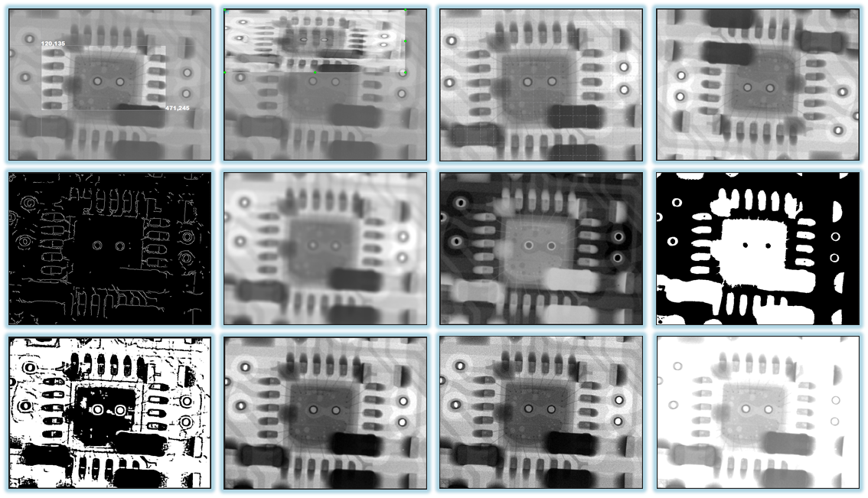
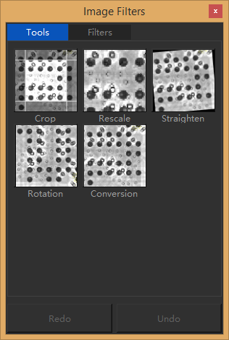
7. Use image filters
Open the Filter panel here
1. Crop Image | 2. Scale Image | 3. Straighten | 4. Rotation
5. Edge detection | 6. Gaussian Blur | 7. Invert Image | 8. Thresholding
9. Local Thresholding | 10. Auto Contrast | 11. Sharpen | 12. Brightness & Contrast
13. Convert Image

Slide 10
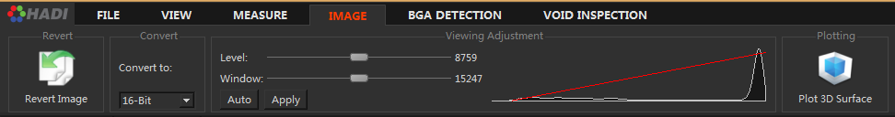
8. For 16-bit image
Revert Image
  Reload image as original
Convert to
  Convert current displaying result to 8bit or RGB etc.
Window/Level
  To adjust the brightness and contrast
  Auto -> automatically
  Apply -> apply current displaying result to image
Shows the current histogram
Plot 3D Surface
  Plot 3D surface the whole image
HADI support 16-bit image as
  Raw image
  Tiff image
After loaded 16-bit image, user can adjust the window/level (brightness/contrast) of it
  Goto “IMAGE” tab

Slide 11
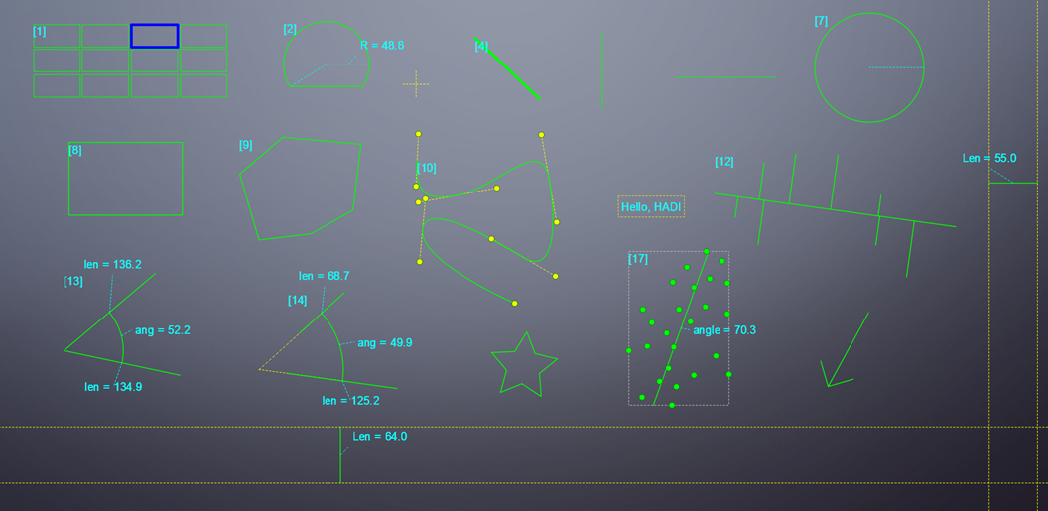
9. Measurement Tools
HADI support 16 measurement tools
1. Grid | 2. Chod | 3.Lins | 4. Rectangle
5. Angle | 6. Text | 7. Star | 8. Arrow
9. Polygon | 10. Spline | 11. Circles | 12. Parallel Lines
13. Point | 14. Perpendicular Lines | 15. Curvature | 16. Lasso tool

