Slide 1
HADI Tutorial
Void Inspection
151101

Slide 2
Contents
Basic Void Inspection Procedure
Smooth ROI
Background Processing (Flatten BG)
Thresholding (Void Segmentation)
Contour Indent
Void Filter
MT Grouping
Mask Tool
Manually remove a certain Voids
Evaluation settings
Others (color, contour, parameters, panels, precision)

Slide 3
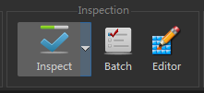
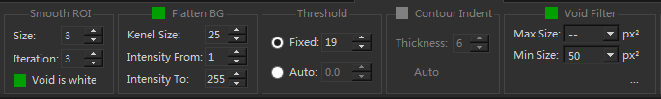
1. Basic Void Inspection Procedure
Create a ROI into image
  Circle, Rectangle or Polygon
Goto “VOID INSPECTION” tab and click “Inspection”
HADI’s can only do Void Inspection Inside ROI
  So before adjusting parameters, user needs to select some ROI.
HADI Void Inspection Procedure
  Smooth Image inside ROI
  Background Processing (optional)
  Do thresholding to segment void
  Outside Contour Trim (optional)
  Void Filtering (optional)
Tips: ROI can be copied by Click-Drag, all parameters will be copied too.

Slide 4
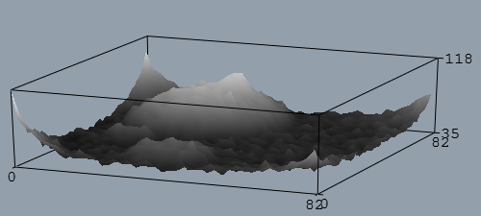
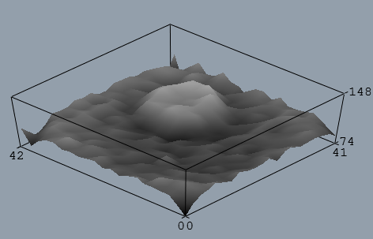
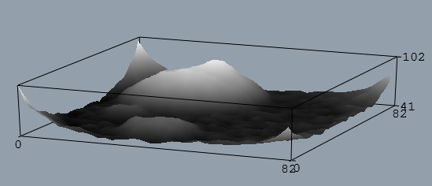
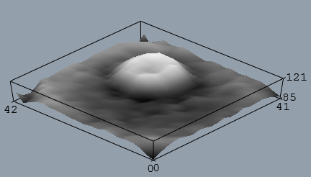
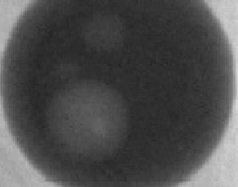
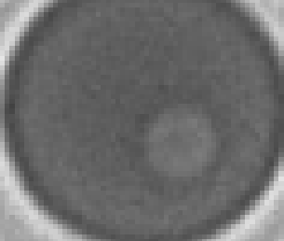
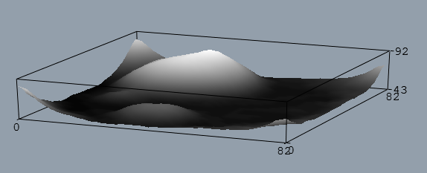
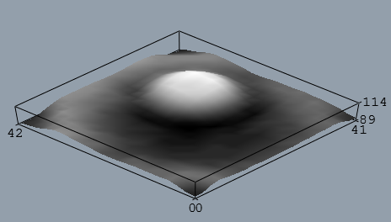
2. Smooth ROI
Sample 1:
Sample 2:
Smooth ROI can reduce the image noise
  This step doesn’t affect result too much, usually just use default value (3,3)
Too much smooth will lose physical truth
Basic Principle:
  Make the image inspectable while reducing smooth size and iterations
Size = 0, Iteration = 0. Original image
Sample 1:
Image Quality is OK, use default
Size = 3, Iteration = 3. Smoothed Image
Sample 2:
Image Quality not good, use heavier smooth parameters
Size = 6, Iteration = 3. Heavy Smoothed Image

Slide 5
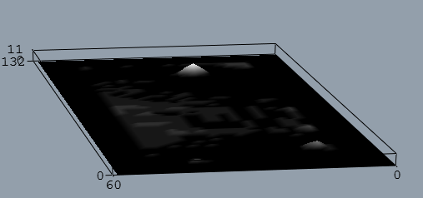
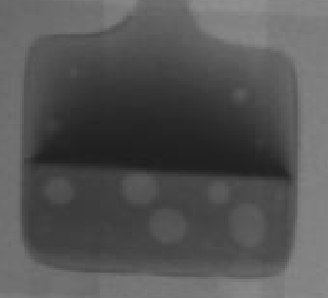
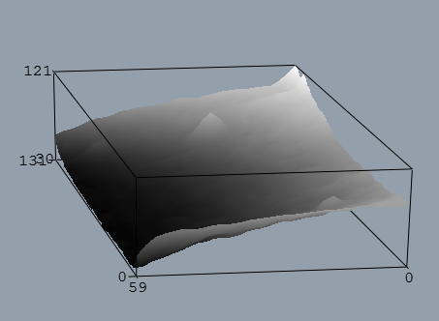

3-1. Background Processing
When use background process?
  Almost all cases, specially BGA case.
Background Processing
The Background becomes homogeneous
Image ROI
3D Plotting ROI
The Background is inhomogeneous
Image

Slide 6
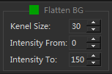
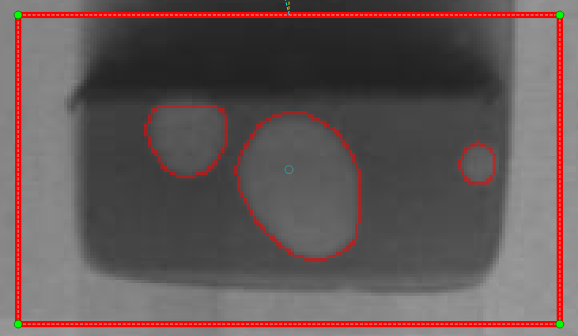
3-2. Background Processing
Parameters
  Kernel size: define the maximum void width or height
    Commonly used values : 25, 50, 80, 100, 150, 200
  Intensity From: remove outer black background
    Commonly used values : 0
  Intensity To: remove outer white background
    Commonly used values : 255
The exact definition of kernel size is :
In the maximum void, kernel size = minimum of width or height
But roughly use common used values is OK.
For example, if min width = 40, kernel size > 40 is OK
But if kernel size = 200, some sharpen background transformation part may not be detected.
Kernel Size

Slide 7
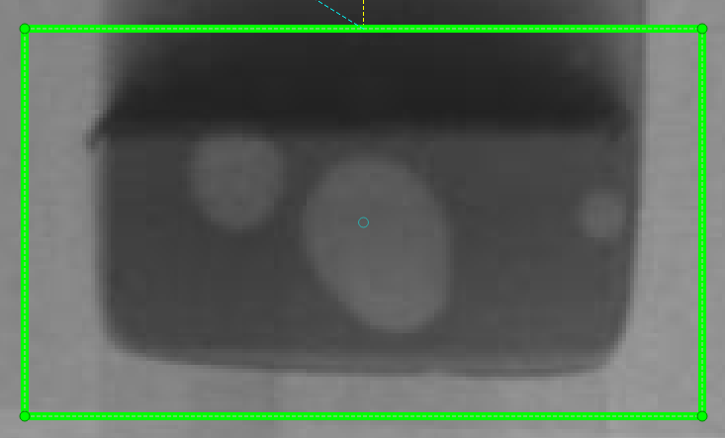
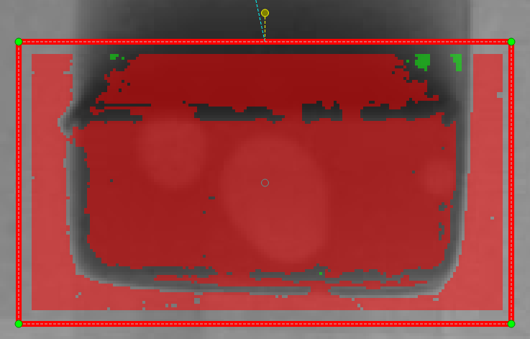
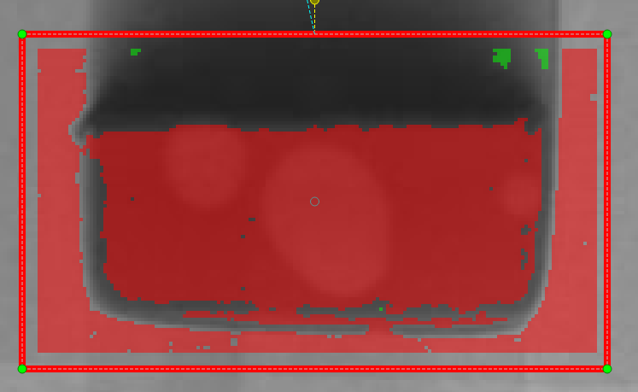
3-3. Background Processing - Intensity From
Original image
Kernel size = 30, from = 0, to = 255, threshold = 1
Intensity From will remove the dark part
Kernel size = 30, from = 50, to = 255, threshold = 1

Slide 8
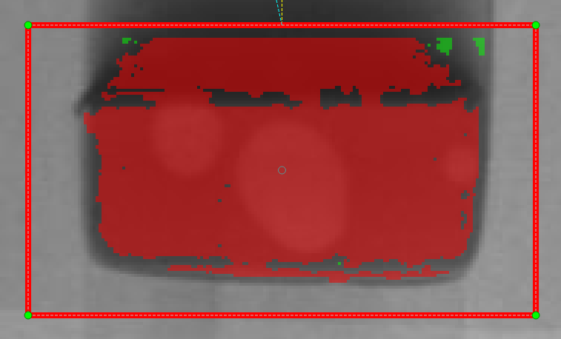
3-4. Background Processing - Intensity To
Original image
Kernel size = 30, from = 0, to = 255, threshold = 1
Intensity To will remove the white part
Kernel size = 30, from = 0, to = 115, threshold = 1

Slide 9
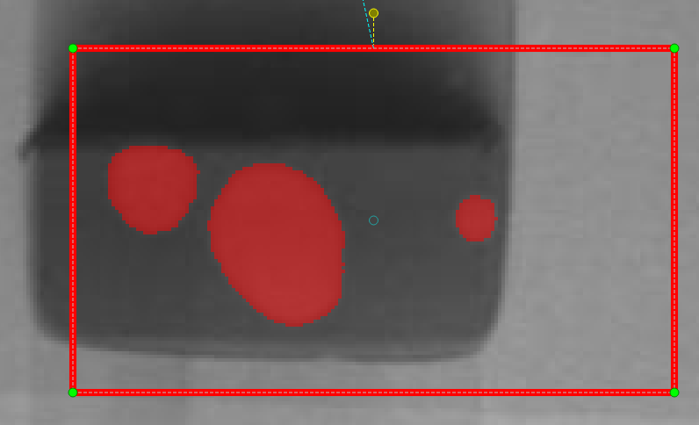
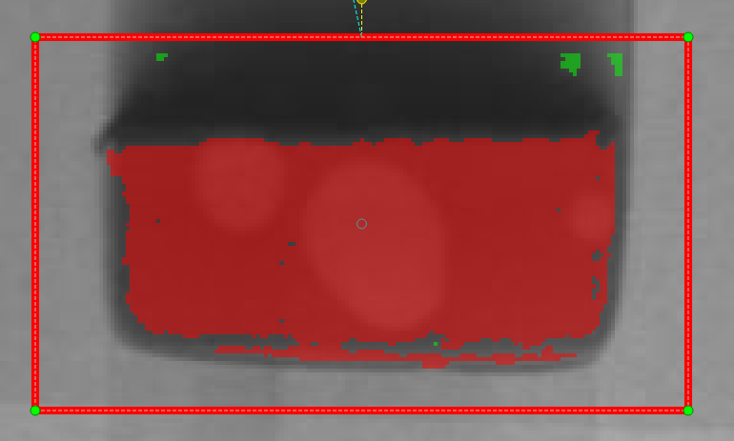
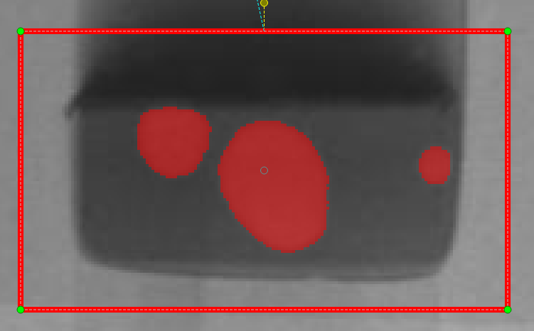
3-5. Background Processing - Intensity From and To
Even ROI moved, inspection result doesn’t change, good for inline
Original image
Kernel size = 30, from = 0, to = 255, threshold = 1
Combine Intensity From and To
Kernel size = 30, from = 50, to = 115, threshold = 1
Kernel size = 30, from = 50, to = 115, threshold = 9

Slide 10
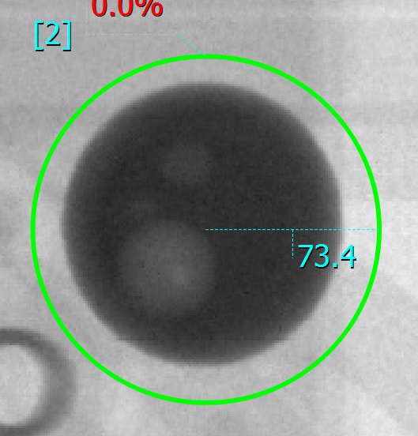
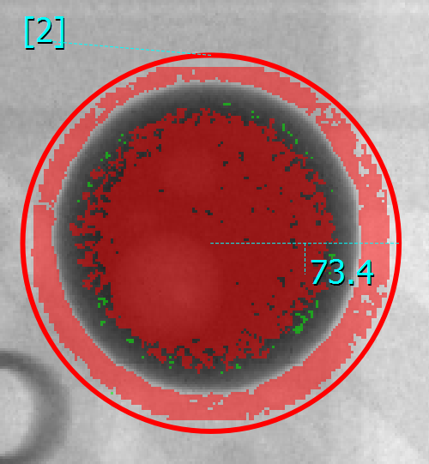
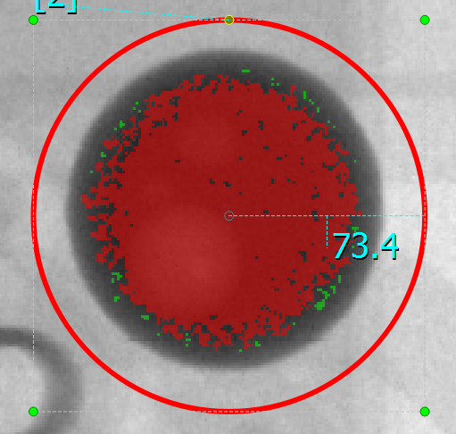
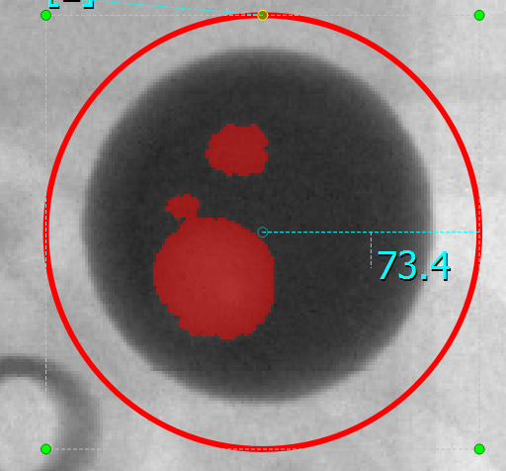
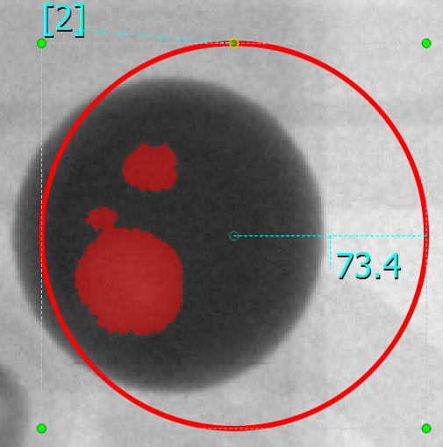
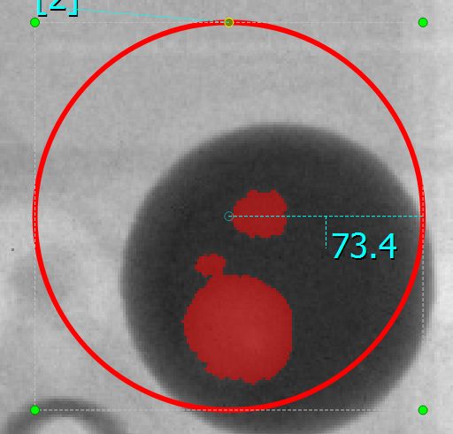
3-6. Background Processing - another case
Original image
Kernel Size = 30
Intensity From = 0
Intensity To = 255
Threshold = 1
To Remove the white outsider
Kernel Size = 30
Intensity From = 0
Intensity To = 255
Threshold = 1
Kernel Size = 30
Intensity From = 0
Intensity To = 255
Threshold = 10
Even ROI moved, Inspection Results are same

Slide 11
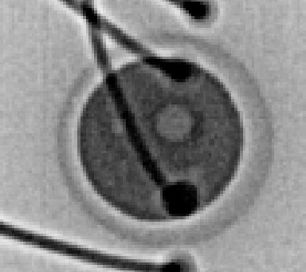
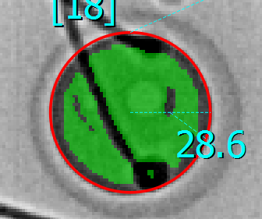
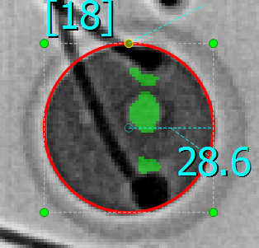
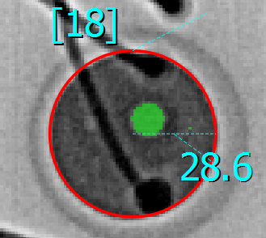
3-7. Background Processing - more difficult case
Original image
Black wires inside Ball
Kernel Size = 30
Intensity From = 0
Intensity To = 255
Threshold = 1
Kernel Size = 30
Intensity From = 0
Intensity To = 255
Threshold = 55
Noise comes out
Kernel Size = 30
Intensity From = 74
Intensity To = 74
Threshold = 6
Best result

Slide 12
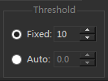
4-1. Thresholding
Thresholding process will separate the foreground and background, usually the foreground is our target.
HADI provide two thresholding method
  Fixed Thresholding (recommended to use)
  Auto Thresholding
After “Flatten BG”, the minimum pixel value will start from 0.
  Usually, “Fixed” = 4 ~ 20
  If use “Auto”, the value is a float value,
    user can increase it to make the segmentation more strict,
    or user can decrease it to make increase the segmentation area.

Slide 13
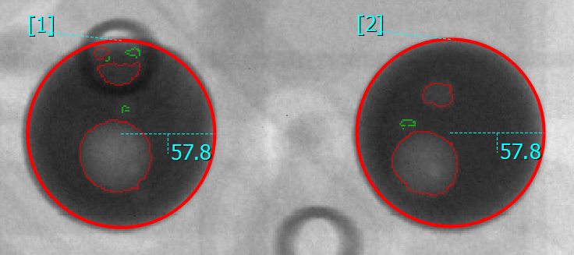
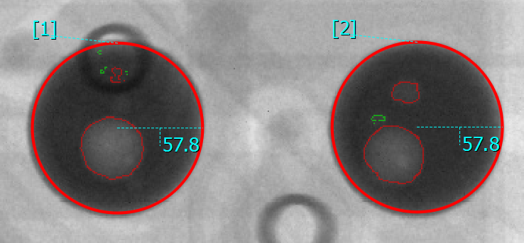
4-2. Thresholding - comparing “Fixed” and “Auto”
Fixed, means HADI use the fixed thresholding value
Auto, means HADI choose a dynamic thresholding value for each ROI
In the right pictures
  Using auto = 1.0, ID 2 choose a thresholding value = 14. Same as the left picture.
  But ID 1 automatically choose a thresholding value = 19. different from 14 in left picture.
  It looks auto is better. But in general case, HADI recommend using “Fixed” value.
Both are using Fixed = 14
Both are using Auto = 1.0

Slide 14
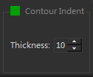
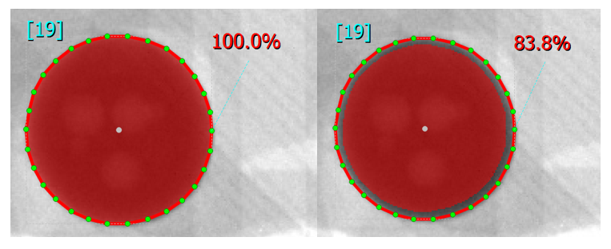
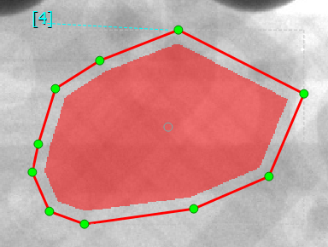
5. Contour Indent
Remove the pixels that adhere to the inner Measurement Tool shape.
  No inspection in the removed area.
The “Thickness” define that how many pixels from the border should be removed.
Thickness = 0
Thickness = 6
Thickness = 10

Slide 15
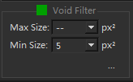
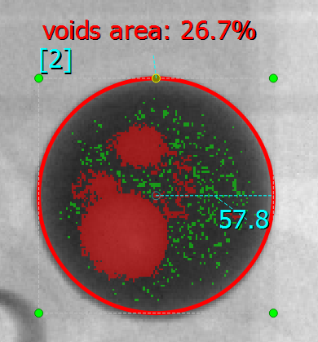
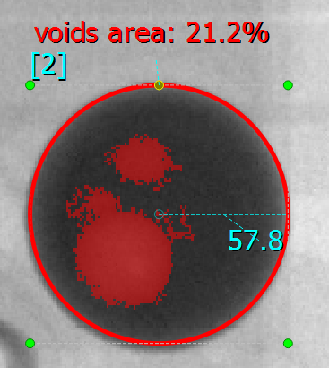
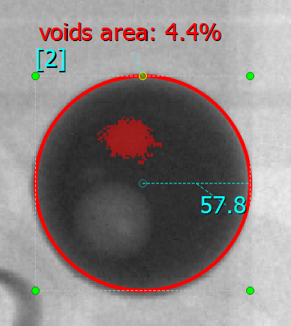
6. Void Filter
Void Filter will remove Voids that in the target range.
Some times user needs to remove voids less than 5 pixel^2 etc.
Some times user needs to remove very large non-void object.
Void Filter Disabled
Void Filter: 50 ~ --
Void Filter: 50 ~ 500

Slide 16
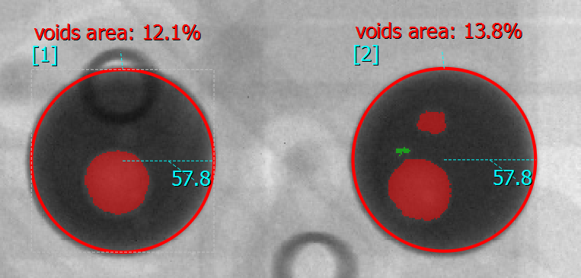
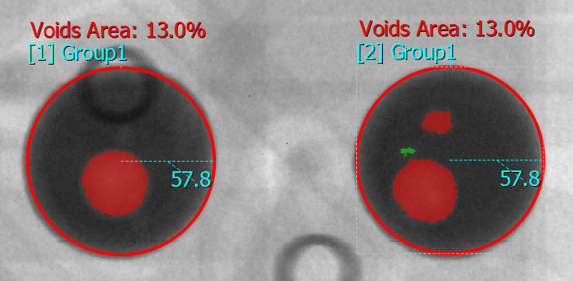
7-1. MT Grouping
HADI Provide MT logical grouping
How to group
  Make the two ROI same Name.
Non-Grouped ROIs
Grouped ROI

Slide 17
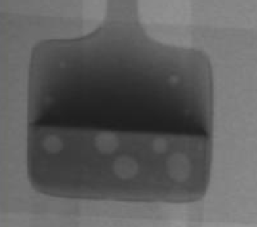
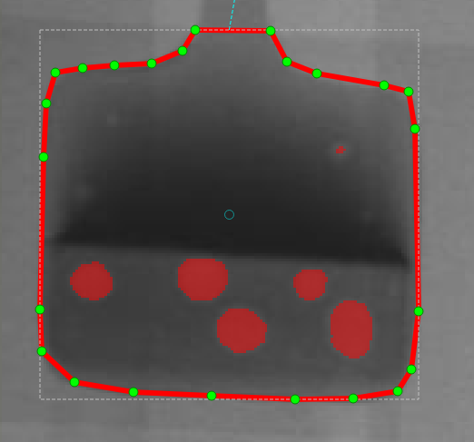
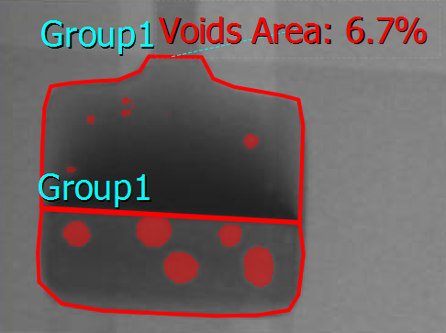
7-2. MT Grouping
Grouping can also used in the case that
  One ROI cannot do perfect inspection
Original image
One ROI cannot find out all Voids
But user want to calculate voids as one Area.
Grouped toghether

Slide 18
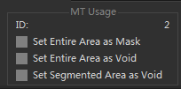
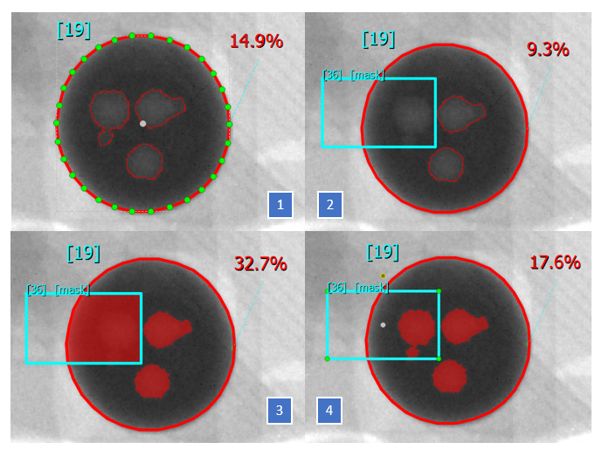
8. Mask tool
In the “MT Usage”, user can set the different usage of a MT.
  If all of the three checkbox unchecked, the selected MT(s) is a Void Inspection tool.
  If any of them checked, the selected MT(s) become a Mask tool with different usage.
  If a MT is a Mask tool, it is not able to do Void Inspection. But it can help the other tool to do Void Inspection.
Example
  Figure 1 shows a Polygon tool that doing Void Inspection. And it’s ratio is 14.9%.
  If we put another rectangle in Figure 2, and set it as Mask tool (“Set Entire Area as Mask”), the Void inside the rectangle will be removed. And the Void ratio for the Polygon is decreased to 9.3%.
  Figure 3, we have set the rectangle tool as Mask tool with “Set Entire Area as Void”, and the Void ratio in Polygon tool is increased to 32.7%.
  Figure 4 is using Mask tool with “Set segmented Area as Void”, user can get different segmentation result by tuning the parameters. It provided a flexible option that user can use various Void finding result and calculate ratio in one ROI.

Slide 19
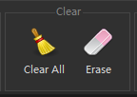


9. Manually remove a certain Voids
In offline inspection, If user doesn’t need some Voids, user can remove them manually
Click on
The mouse cursor becomes
Click on any Void, the Void will be removed.
Click on “Erase” again to stop removing.
Tips: Even do Inspection again, these voids doesn’t come out. Until user click on “Clear All”.

Slide 20


10. Evaluation Settings
Void Width
  Width of a void
Void Height
  Height of a void
Void Area
  Pixel Area of a void
Void Dia.
  Void diameter is the maximum distance inside the void.
  Or, try to fit a minimum circle to a Void, and the diameter is the circle diameter.
Total Voids Count
Biggest Void Area Ratio
  The Biggest Void area
Biggest Void Dia. Ratio
  The biggest Void diameter
Total Void Area Ratio
Total Void Dia. Ratio
All Evaluations are dedicated to ROI
All the numbers are defining NG

Slide 21


11-1. Others
User can use to restore all inspection parameters
User can set defect color and non-defect color
  Both defect and non-defect are Voids
User can show Void Contour by checking “Void Contour”
  It is good for user to evaluate the segmentation quality of Voids
Most important parameters
  “Flatten BG” -> kernel Size
  “Thresholding” -> Fixed
  With above two parameters, user can do Void Inspection very well in most case.

Slide 22



11-2. Others
For more detail statistical information
  User needs to open “Measurent tools” and “Defects” dock panels

Slide 23




11-3. Others
If user need higher precision
  Goto “Measure” -> “Precision”
Precision = 1
Precision = 3
Precision = 5

